Slide 1
I4
SUNHOKEY

Slide 2
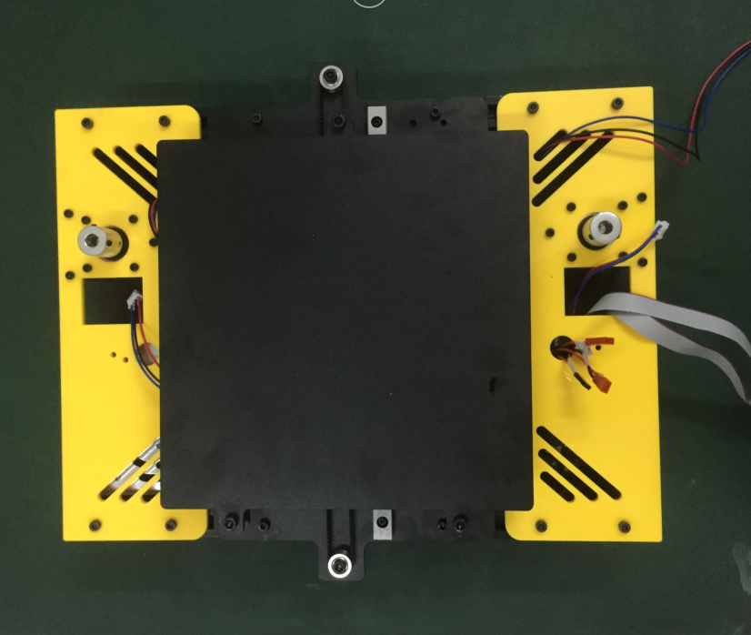
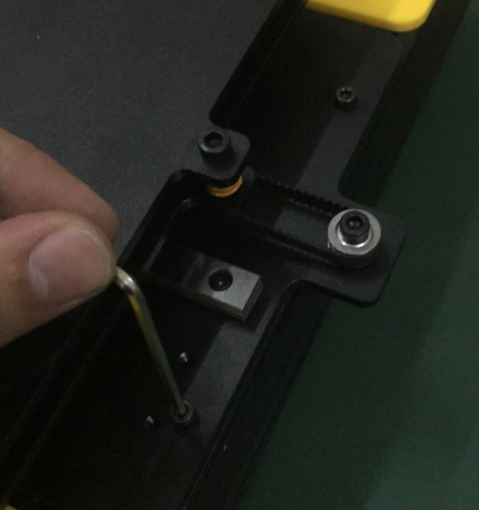
step1:Unscrew 4pcs of screws to take the heatbed apart from the base

Slide 3
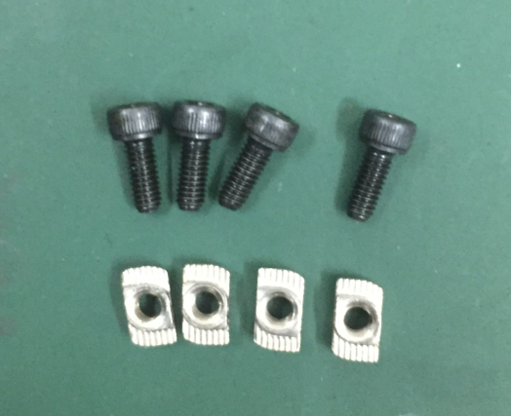
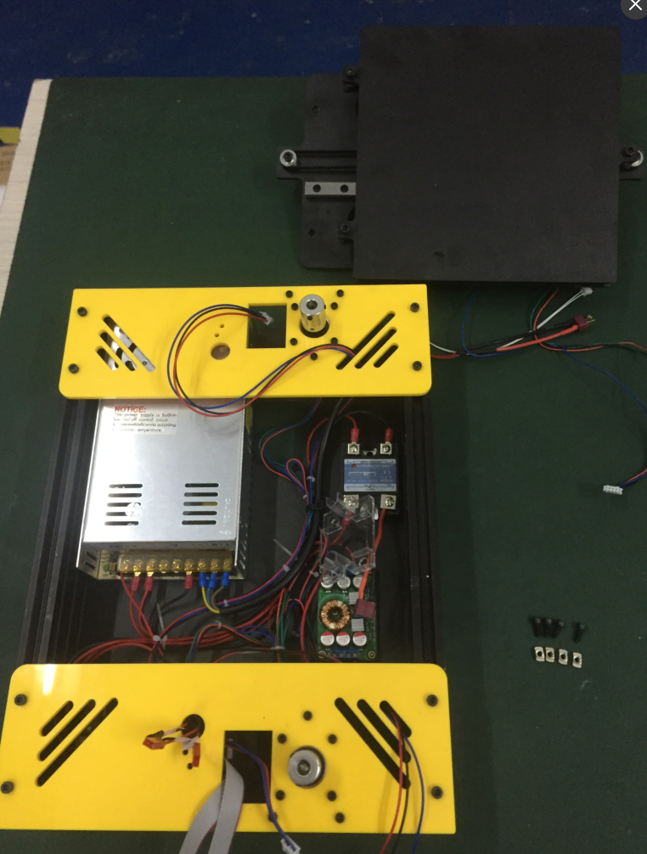
after step1 finishes, it looks like below

Slide 4
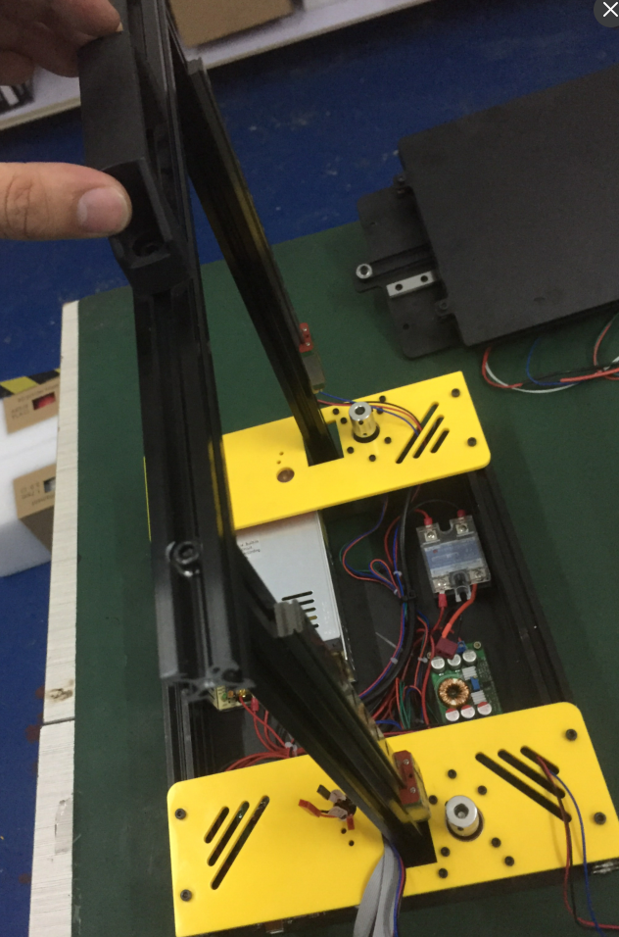
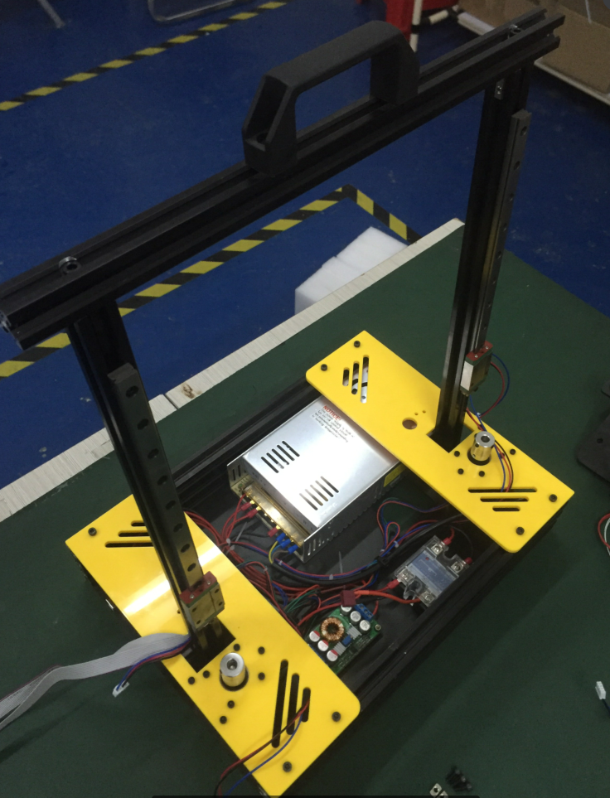
Step2:install the frame
Pay attention please, don't make the back to front.

Slide 5
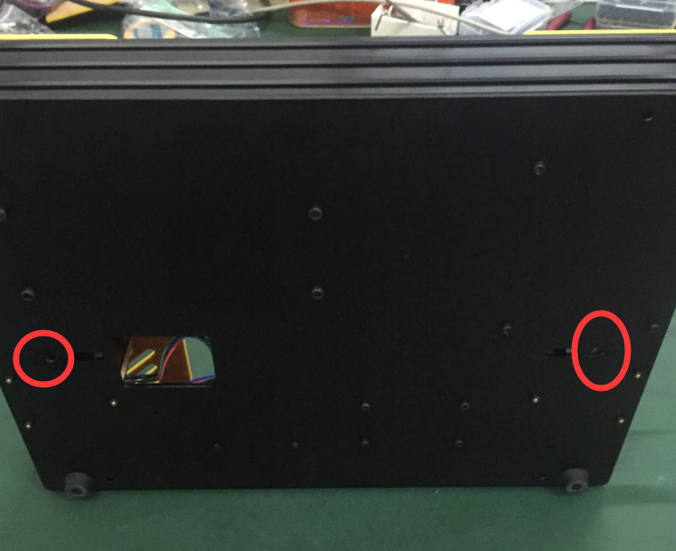
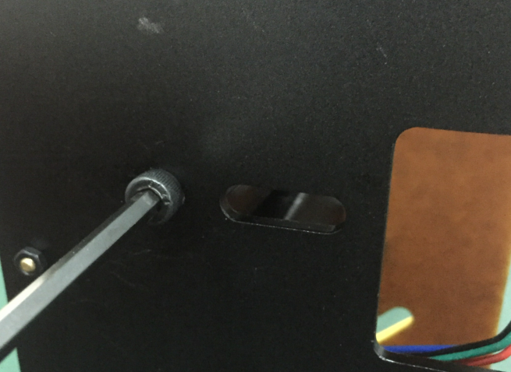
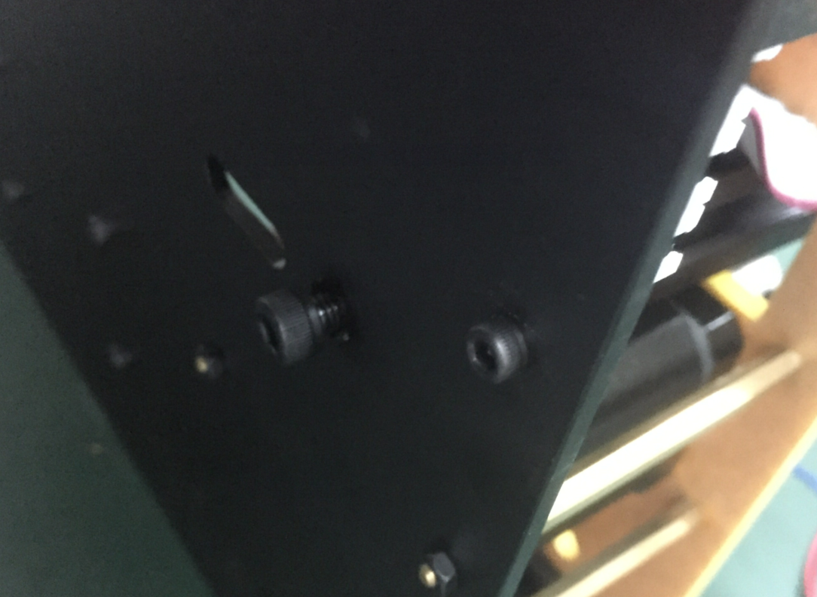
Step3:fix the frame from bottom of base with screws: M5 X 12 2PCS

Slide 6
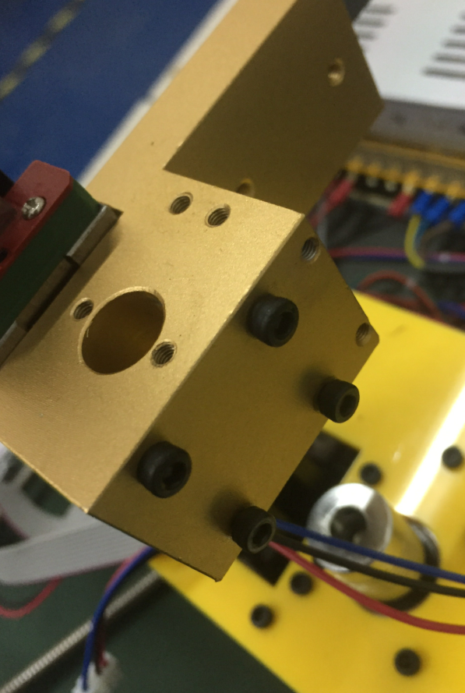
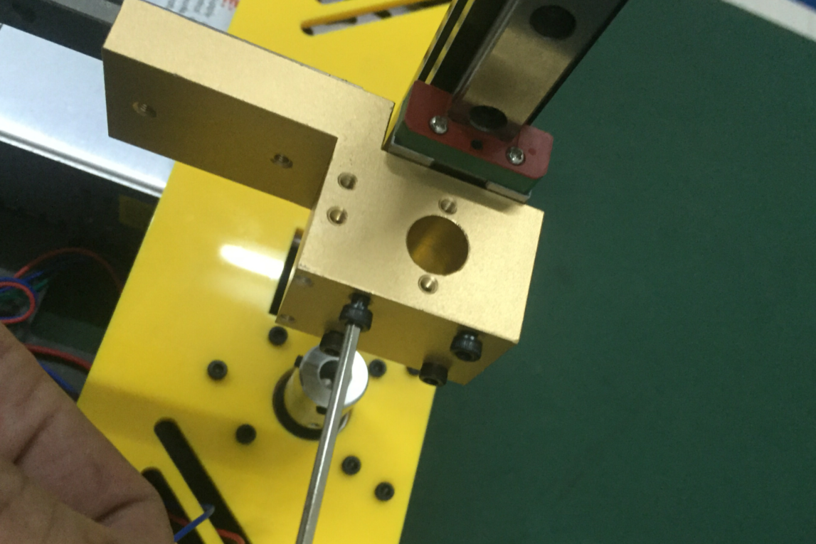
Step4: install the leadrail of the X axis with screws: M3 X 30 8 PCS PS:please read STEP 5 as a reference

Slide 7
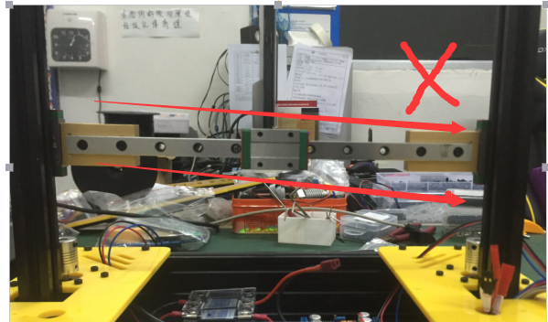
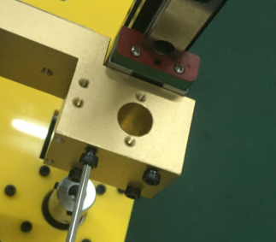
Step5: Pay attention
if the leadrail is not level after you screw, please unscrew and adjust it to level.

Slide 8
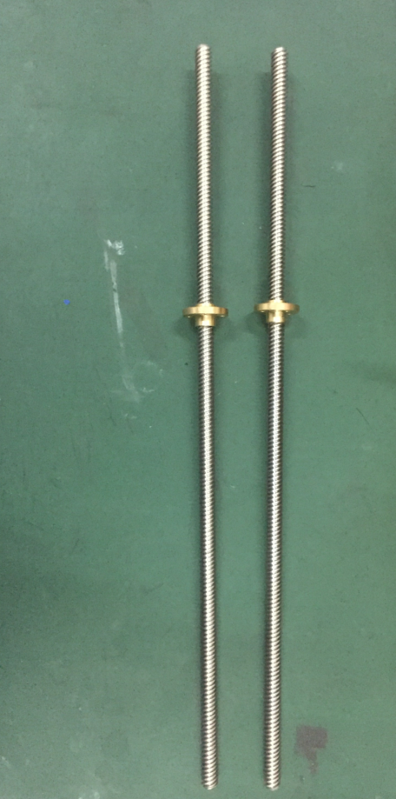
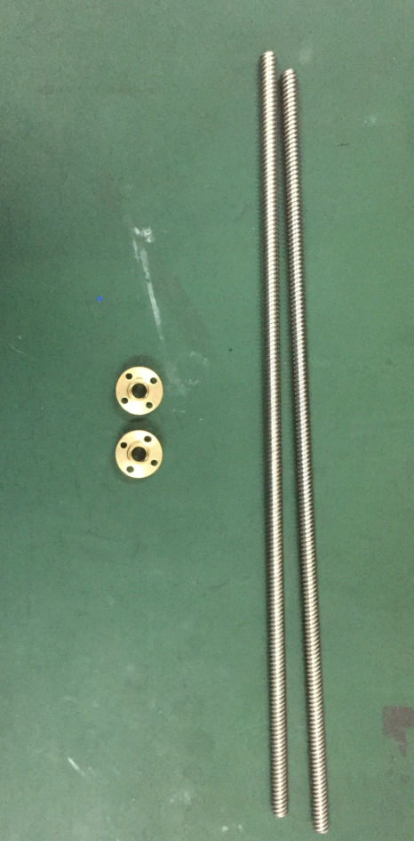
Step6: install T8-leadscrew
take the copper nut from
the T8-leadscrew

Slide 9
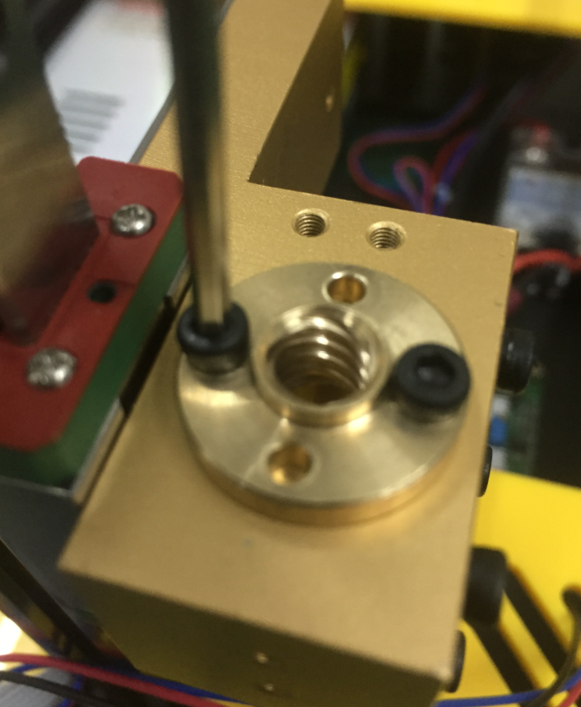
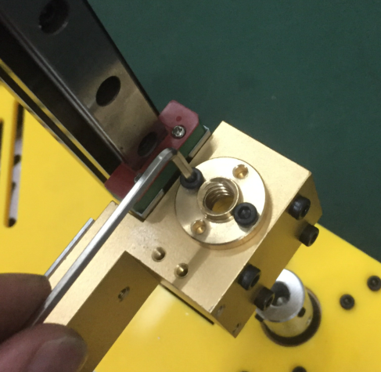
Step7: Fix copper srew nut to the leadrail with: M3 X 8 4 PCS

Slide 10
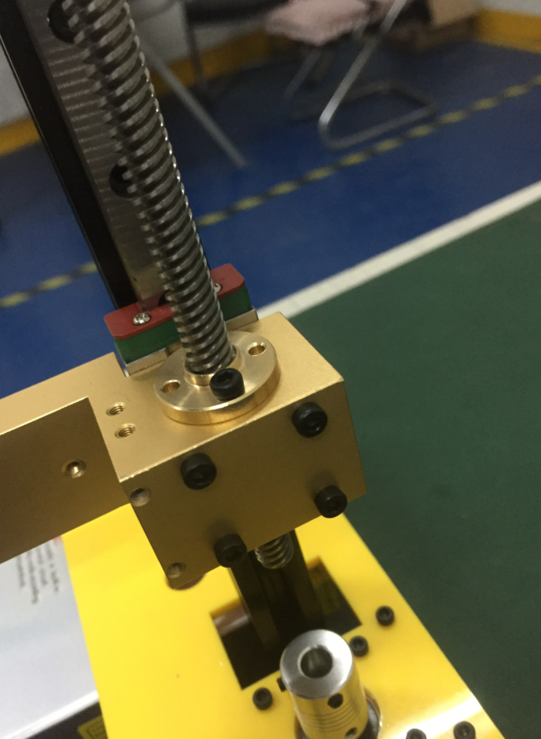
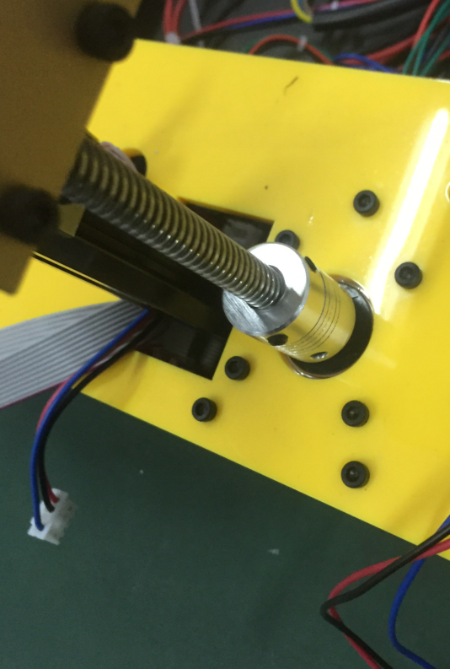
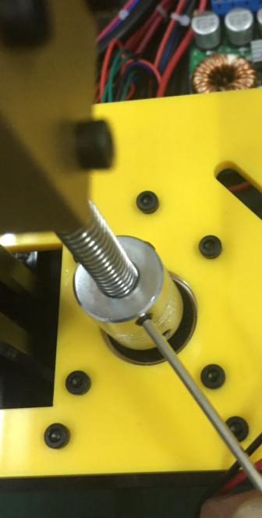
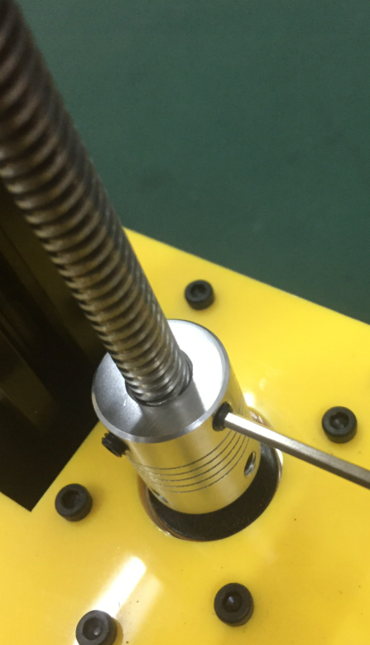
Step8: Install and fix T8 leadscrew to the coupler

Slide 11
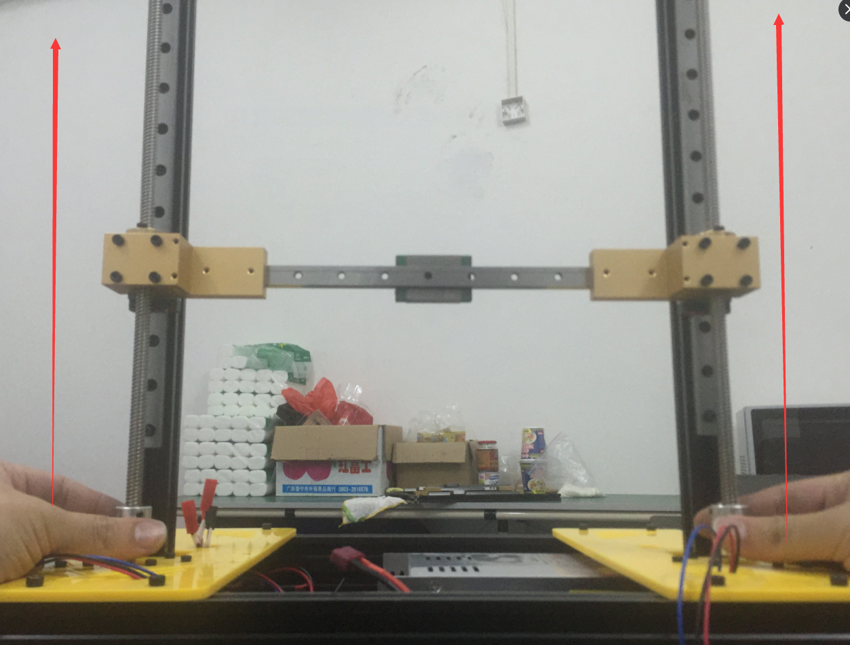
Step9:Pay attention
After you install the T8 leadscrew, please test if you
can turn the coupler to move the leadrail up and down.
Please turn both coupler at the same time from the very
bottom to very up. Usually, its very easy to be turnt.
if it's too tight to move, please stop turning and
refer to next step for adjusting. If it moves smoothly,
ignore step 10. Must pay attention to the fault
because it would cause the motor can't drive
the leadrail so that the printer can't work

Slide 12
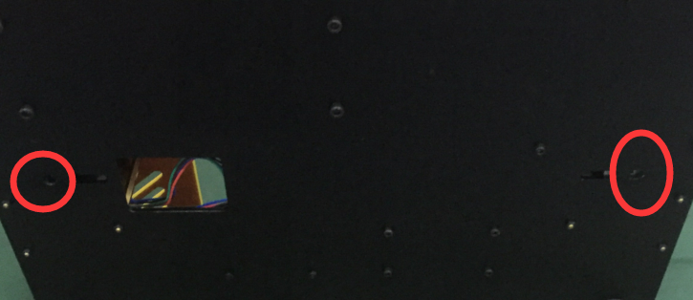
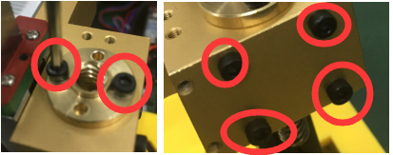
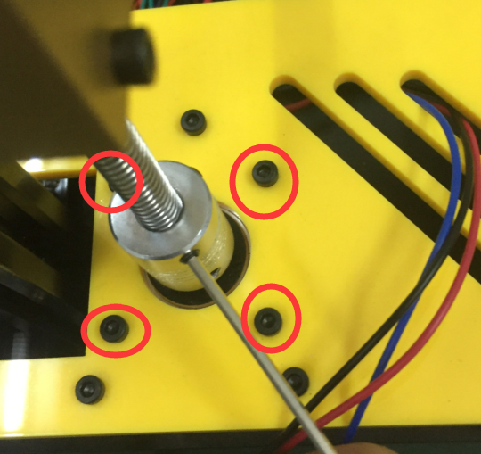
Step 10: Find the reason for the fault of step 9
Please check the screws one by one
to see if they are screwed too tight
Must pay attention to the fault
because it would cause the motor
can't drive the leadrail up so that the
printer can't work

Slide 13
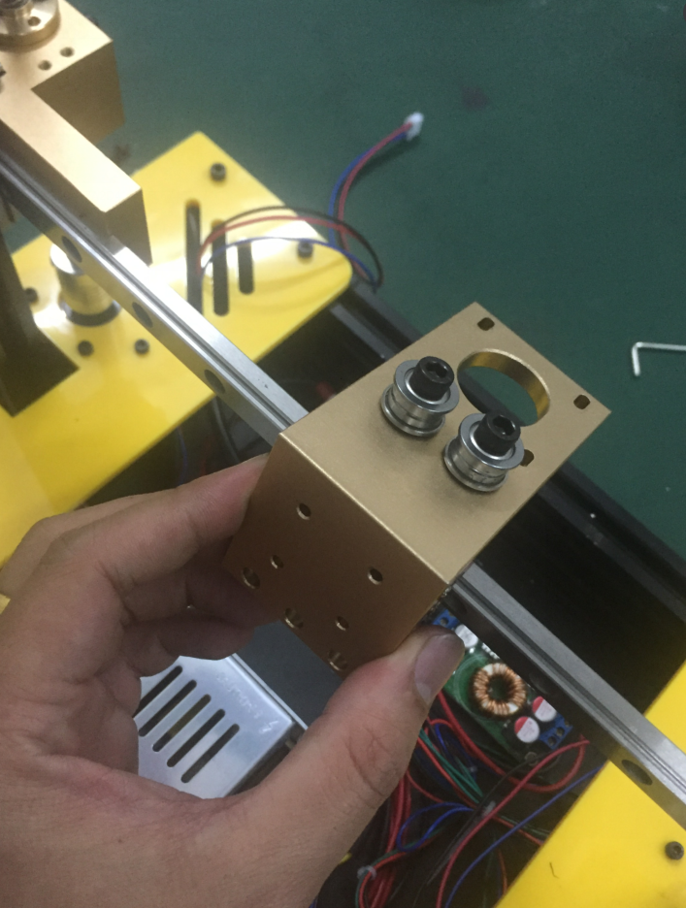
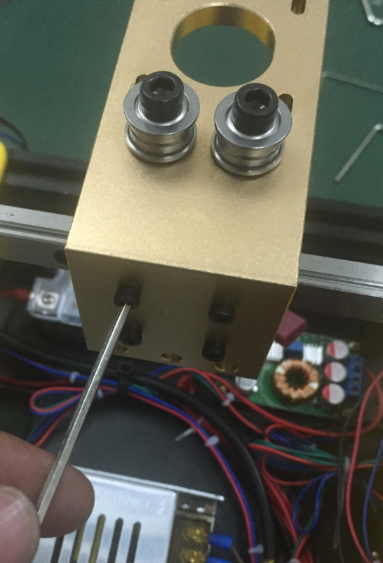
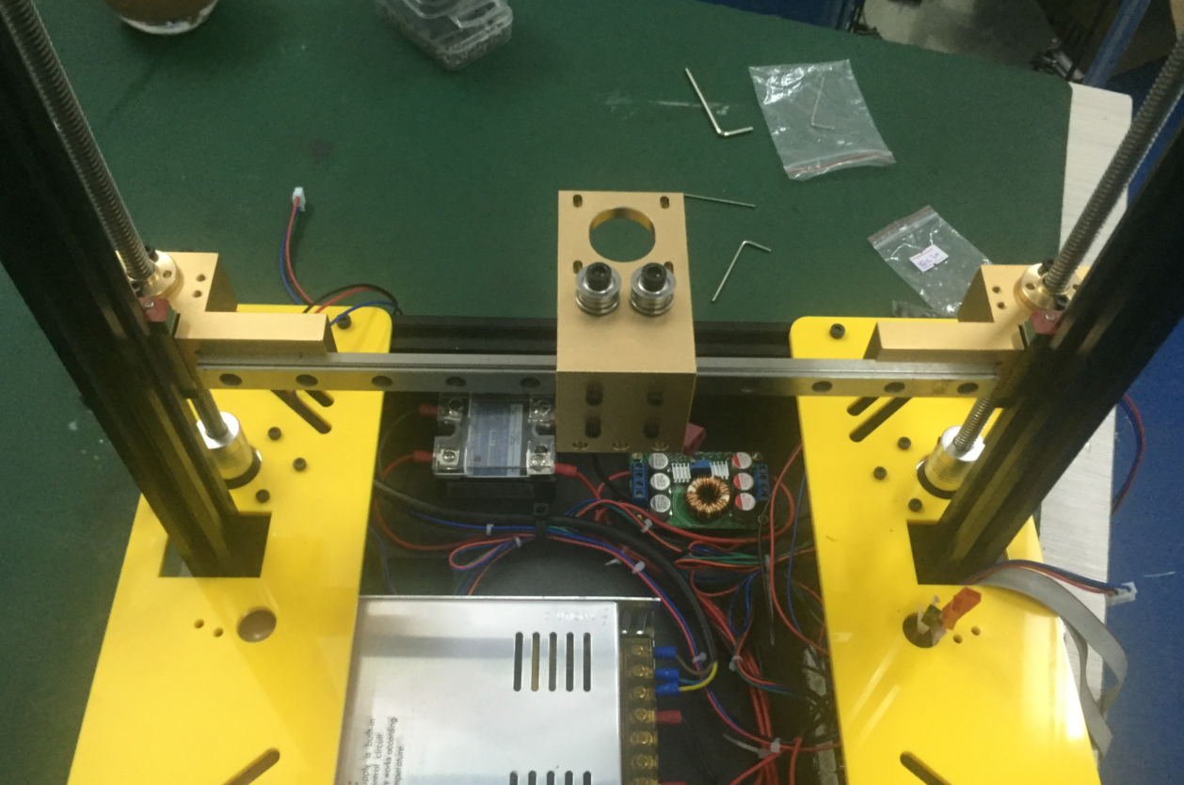
Step11: Fix the extruder holder to the X axis with screws: M3 X 8 4PCS
Don't make the back to front

Slide 14
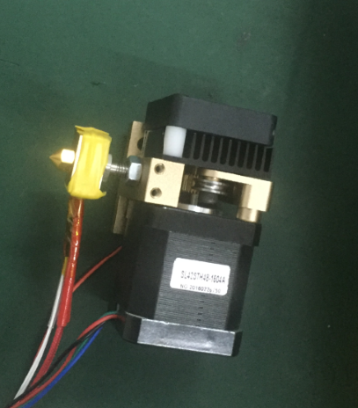
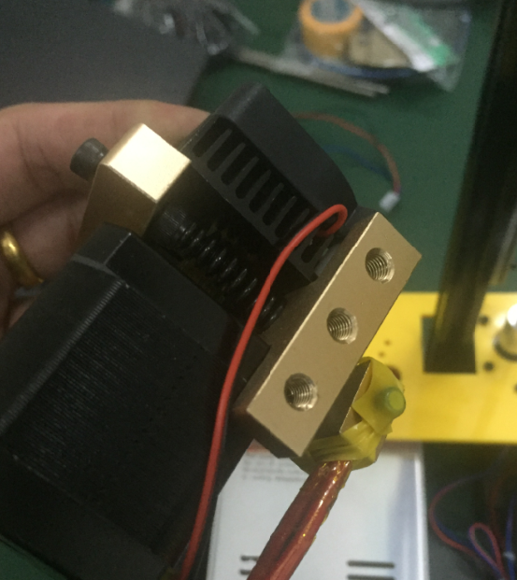
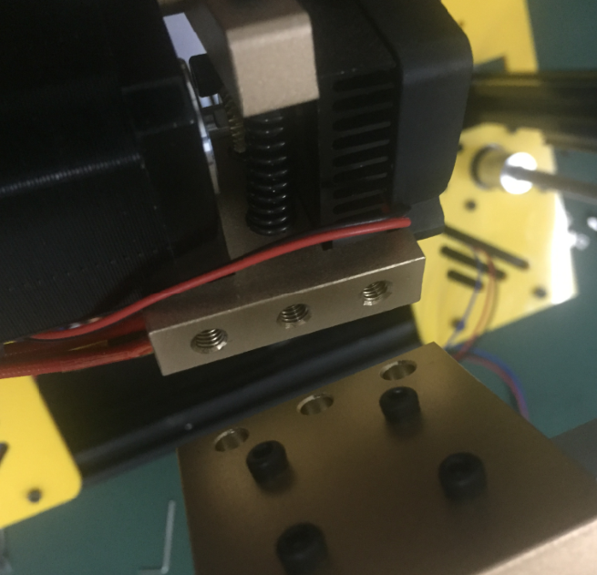
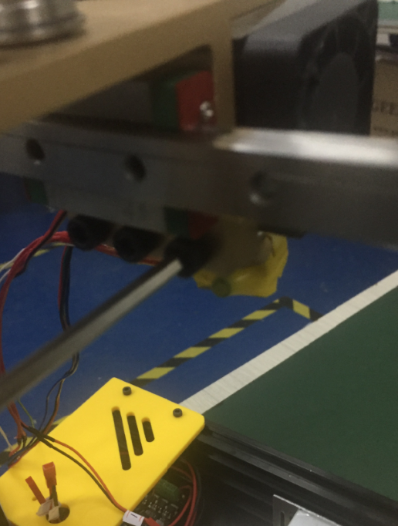
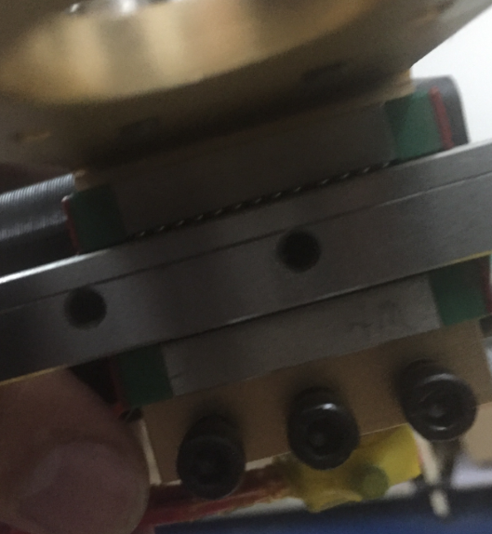
Step12:Install the extruder to X Axis with screws: M5 X 12 3PCS
Don't make the back to front

Slide 15
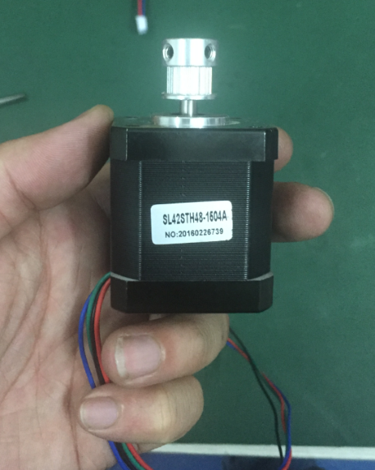
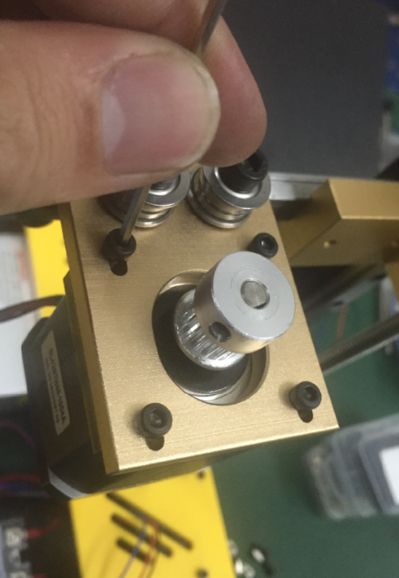
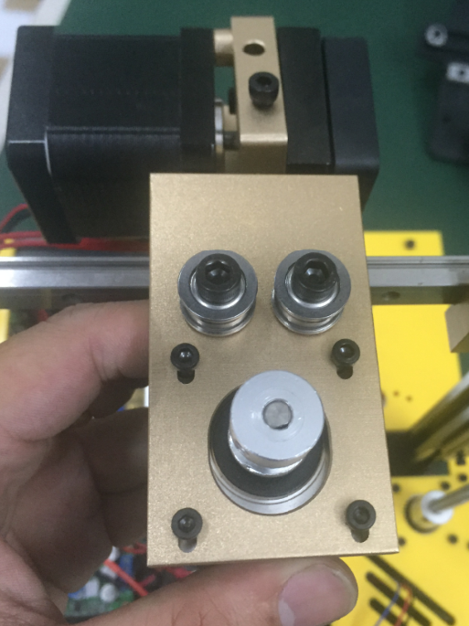
Step13: Install stepper motor to the X Axis with screws: M3 X 8 4PCS

Slide 16
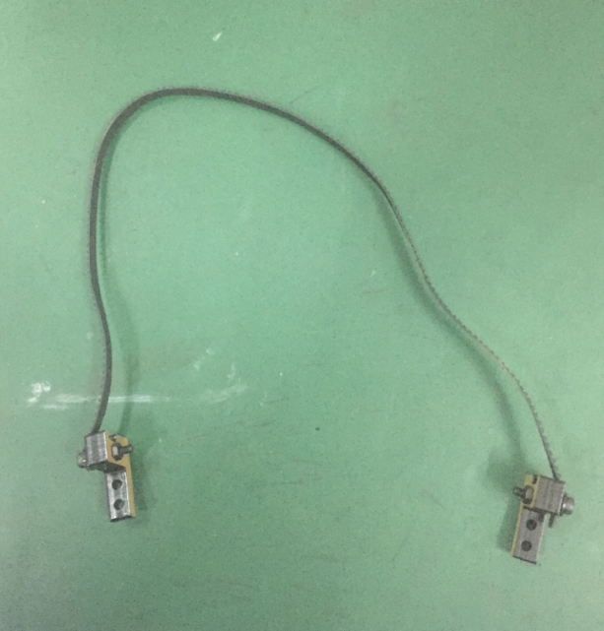
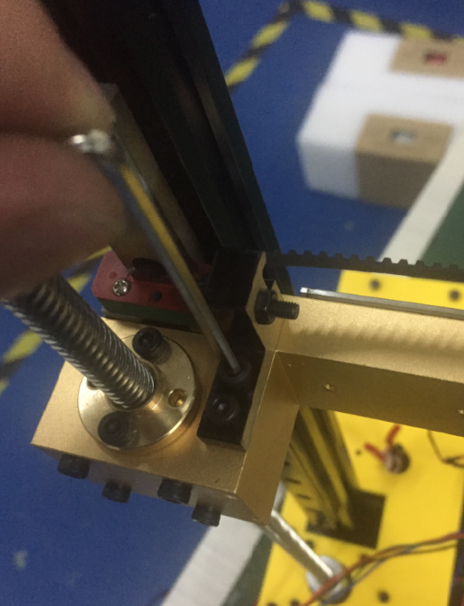
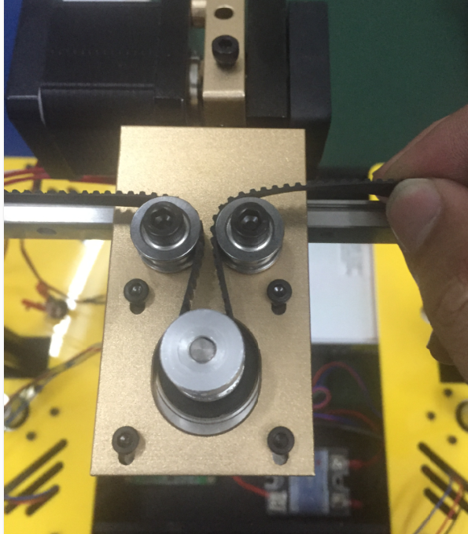
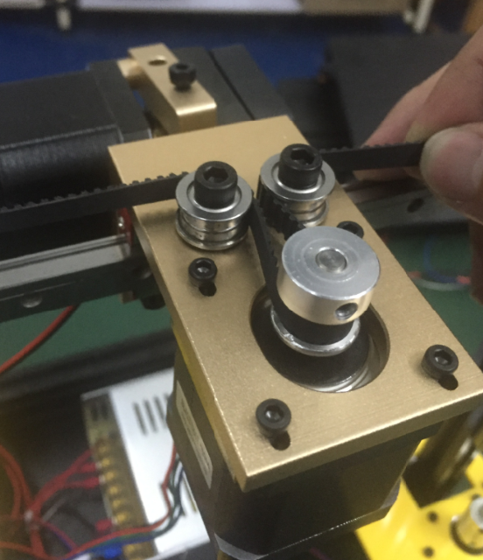
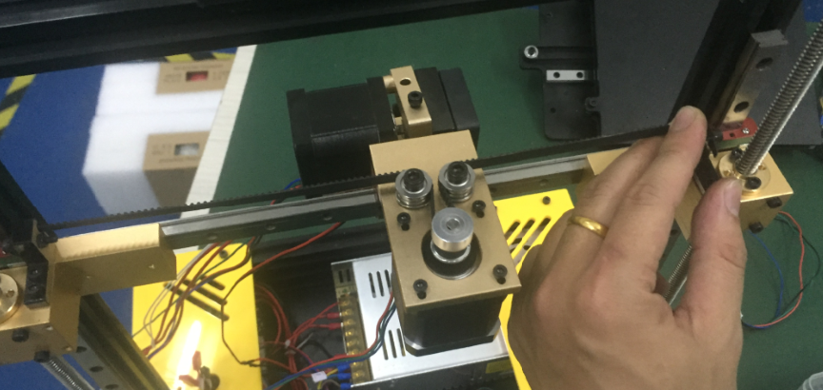
Step14:Install belt to the X Axis: M3 X 8 4PCS

Slide 17
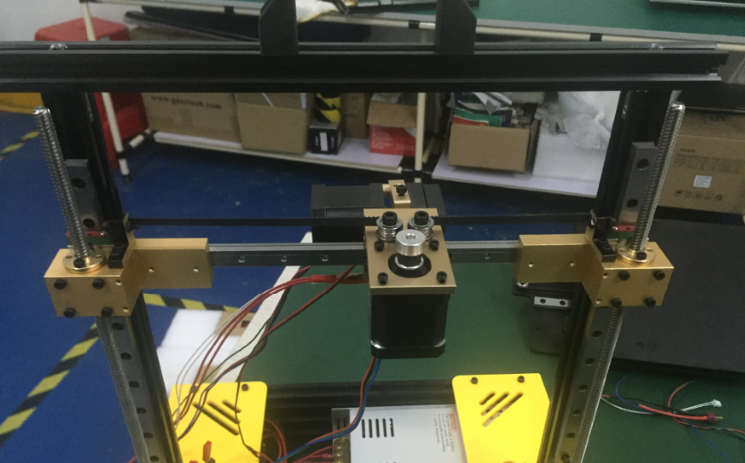
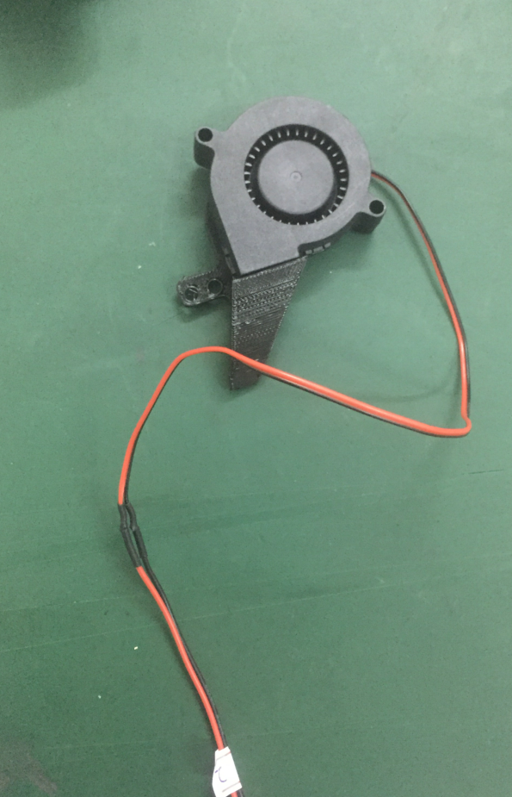
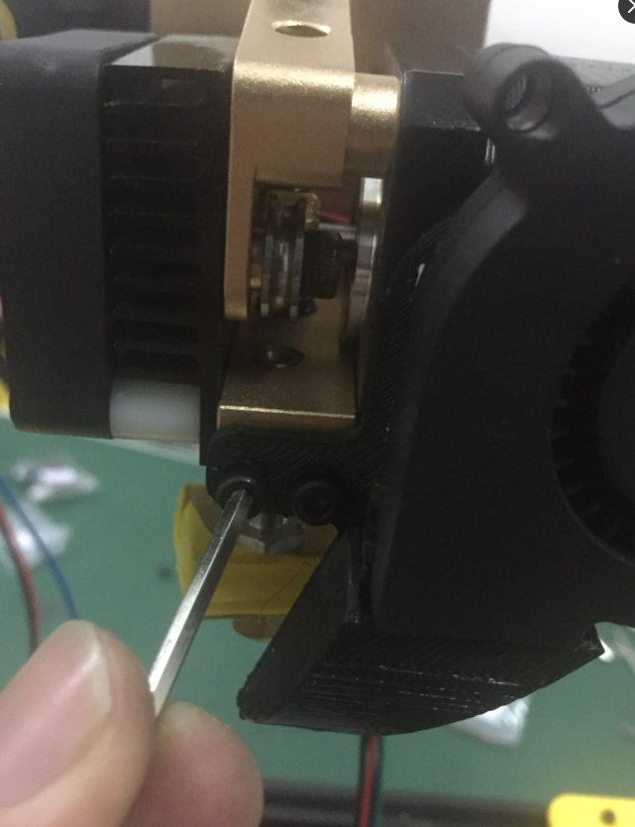
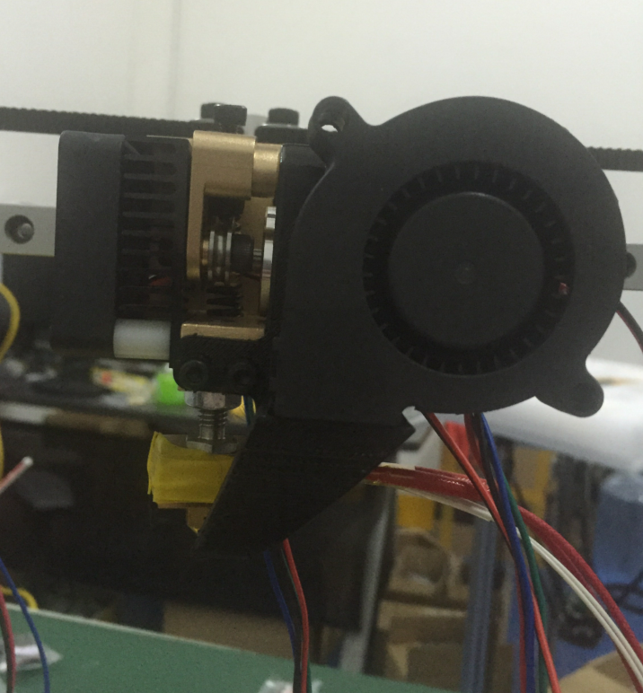
Step15: Fix Turbofan with screws: M3 X 8 2PCS

Slide 18
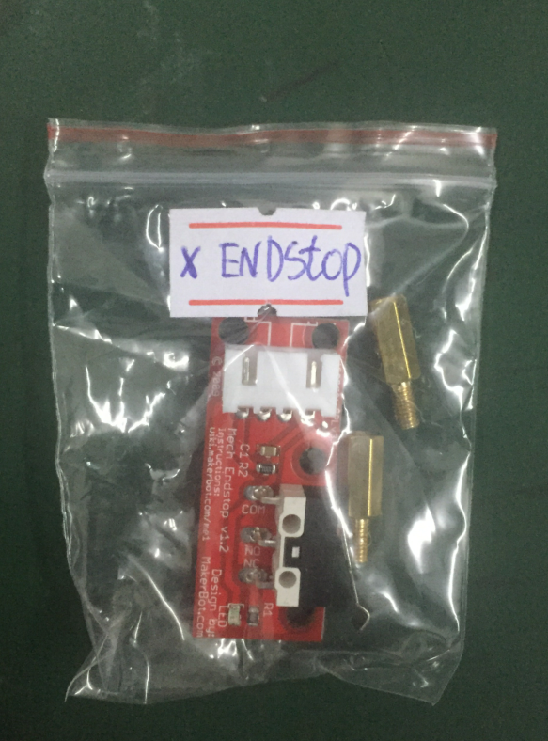
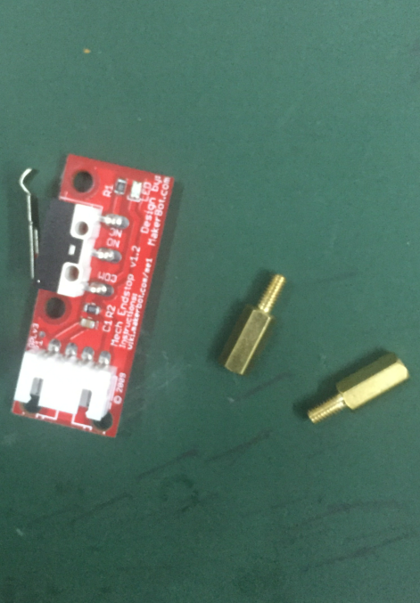
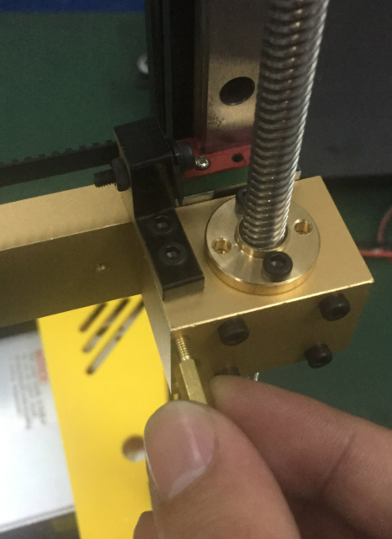
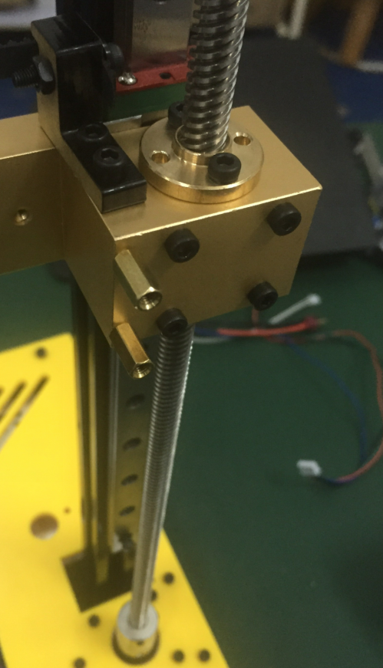
Step 16：Install X -ENDSTOP

Slide 19
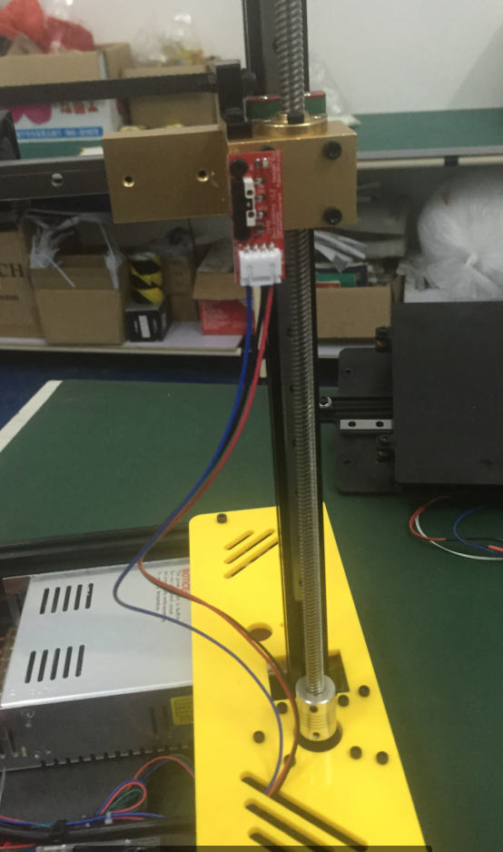



Step17：Install- X ENDSTOP
M3 X 8 2PCS

Slide 20



Step18：Wiring of the Cooling Fan
Find No.1 (wire of 12V cooling fan)and connect it to the right position.
pay attention: Red to Red. Black to Black

Slide 21


Step19：Wiring of the Turbofan
Find No.2 (12v turbofan) and connect it to right position
Pay attention: Red to Red. Black to Black

Slide 22

Step20：Wiring of Heater
Find No.3(24v Heater) and connect it to the right position
Pay attention: Red to Red, Black to Black

Slide 23




Step21：Wiring of the thermistor of hotend
Please find the thermistor of the hotend, and connect it to A13 of the Mainboard

Slide 24




Step22：Wiring of the X-Axis stepper motor
please find the stepper motor of the X-Axis, and connect it to X_MOT of the Mainboard

Slide 25




Step23：Wiring of the extruder stepper motor
Please find the stepper motor of the extruder, and connect it to E0_MOT of the Mainboard

Slide 26





Step24: Install the Z-Axis ENDSTOP
Unscrew
ensure the small part touch the base
screw tight
complete

Slide 27


Step25：Wiring of the Z-Axis endstop
connect them together

Slide 28



Step26：Install heating bed and Y Axis
find the connector of the Y-Axis stepper and connect it to Y_MOT of the Mainboard

Slide 29

Step27：Wiring of the Y-Axis stepper motor
Connect the Y-Axis stepper motor to Y_MOT of the Mainboard

Slide 30



Step28：Wiring of the thermistor of the heatbed
get it through the hole
Find the thermistor of the heatbed and connect it to A14 of the main board.

Slide 31


Step 29：Install the Y- Axis

Slide 32


Step30：Install heatbed
注意热床的方向，以图作为标准

Slide 33


Step31：Install heatbed
rescrew the four screws as before they were taken apart and then block them.

Slide 34



Step32：install the heatbed
rescrew the four screws as before they were taken apart and then block them.

Slide 35



Step33：Install Y-Axis endstop with: M3 X 8 2PCS

Slide 36



Step 34：Wiring of the Y-Axis endstop

Slide 37



Step35：Fix both acrylic frame
Fix the the frame with power supply: M5 X 12 7PCS

Slide 38


Step 36：Install LCD in the top acrylic frame
connect the two wires with LCD first

Slide 39

Step 37：Choose the correct voltage in the power supply. It's very important.
this step is very important. if you don't make the voltage correctly, it will cause printer burnt
after you finish previous installation, you should test the printer before you finish the rest installion.
But before testing, you must choose the correct the voltage first.
There is a voltage switch in the power supply. one side is 230v, one side is 115v. if your local voltage is 220v, please turn the switch to 230v side. if your local voltage is 110v, please turn the switch to 115v
side.

Slide 40



Step 38：Test the printer
after you confirm the correct voltage, please let the printer power on. Working status would be: the fan works, LCD can display like the picture.

Slide 41




Step39：Problems would occur while testing
messing codes occur in the LCD, please press the buttoon
like the picture
no any characters in the LCD,
please ensure you have done correct wiring.

Slide 42




Step40：Test the endstop
after fixing the printed part, please turn the screw to very bottom, which can ensure the hotend don't touch the heatbed
Fix the printed part of Z axis endstop to the place as the pictures show

Slide 43






Step 41：Test all endstops
1. press the button ->turn it to 'Prepare' and press ->turn the button to ' Auto home ' and press
test the endstop with lcd
X-Axis ENDSTOP is Auto home
Z-Axis ENDSTOP is Auto home
Y-Axis ENDSTOP is Auto home

Slide 44





Step42：Install the top acrylic framce
Put M3 *20screws into the hole of top acrylic frame
fix the screws in the hole with tape

Slide 45



Step 43：Install top acrylic frame
Fix top acrylic frame with M3*20 screws，ATTENTION：Acrylic frame is fragile, please screw it carefully

Slide 46

Step44：Tie the wires

Slide 47

Step 45：Testing and Calibration
level the heatbed through adjusting the 3 screws
distance between nozzle and headbed is the thickness of a pcs of A4 paper. Meanwhile, you can move the paper smoothly between them.

